Slide 1

Note: The data and information in this document is reflective of a hypothetical situation and client. This document is to be used for KPMG Virtual Internship purposes only.
Sprocket Central Pty Ltd
Data analytics approach
[Division Name] - [Engagement Manager], [Senior Consultant], [Junior Consultant]

Slide 2
Note: The data and information in this document is reflective of a hypothetical situation and client. This document is to be used for KPMG Virtual Internship purposes only.
Agenda
Introduction
Data Exploration
Model Development
Interpretation

Slide 3
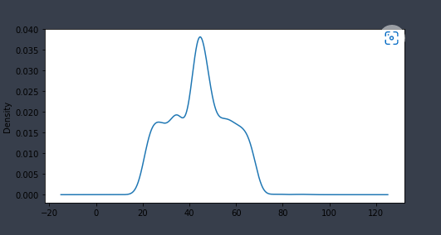
Note: The data and information in this document is reflective of a hypothetical situation and client. This document is to be used for KPMG Virtual Internship purposes only.
Introduction
Customer Analysis
DOB to Age Conversation
Number of bike purchased in 3 yr.
Job industry category
No. of cars purchased gender wise
No. of cars purchased state wise
Place any supporting images, graphs, data or extra text here.

Slide 4
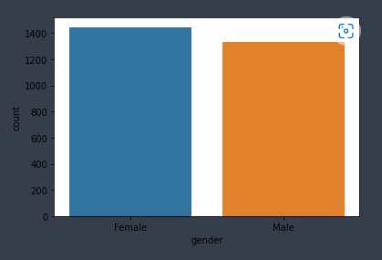
Note: Th data and information in this document is reflective of a hypothetical situation and client. This document is to be used for KPMG Virtual Internship purposes only.
Data Exploration
1446
Frequency of Male And Female
After Dropping the NaN rows we have 2779 rows in out dataset
Two unique value present in Gender column of Demographic dataset Male and Female.
In which 1446 Female and 1333 Male Customers are there.
Place any supporting images, graphs, data or extra text here.

Slide 5
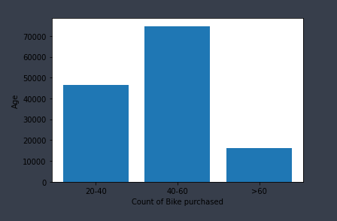
Note: The data and information in this document is reflective of a hypothetical situation and client. This document is to be used for KPMG Virtual Internship purposes only.
Data Exploration
Bike Purchase group by age
Customers of age between 40 to 60 purchased maximum number of Bikes in past 3 yr.
Customer of age greater than 60 purchased very less number of bikes
However age between 20 to 40 purchase average bikes
Place any supporting images, graphs, data or extra text here.

Slide 6
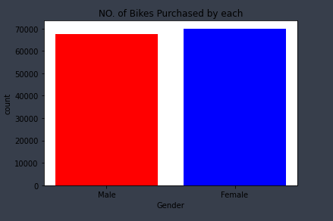
Note: The data and information in this document is reflective of a hypothetical situation and client. This document is to be used for KPMG Virtual Internship purposes only.
Model Development
Bike purchased by male and female in past 3 yr.
No. of bikes purchased by male and female are : 67398 ,70013
By analysing the data we find that the 51% of total bikes are purchased by Female Candidate and rest 49% by Male.
Place any supporting images, graphs, data or extra text here.

Slide 7
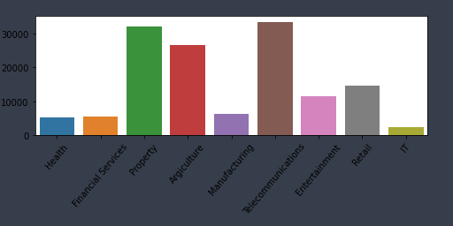
Note: The data and information in this document is reflective of a hypothetical situation and client. This document is to be used for KPMG Virtual Internship purposes only.
Model Development
Bike Purchase group by Industry
There are 9 unique categorical feature in Job Industry
The greatest number of bike purchased by the Electrocommunication sector and Property dealers.
Place any supporting images, graphs, data or extra text here.

Slide 8
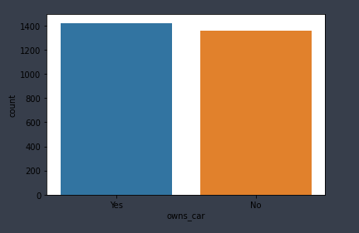
Note: The data and information in this document is reflective of a hypothetical situation and client. This document is to be used for KPMG Virtual Internship purposes only.
Model Development
Car Purchased
Total 1421 numbers of people owned car as well as bike and 1358 didn’t.
Place any supporting images, graphs, data or extra text here.

Slide 9
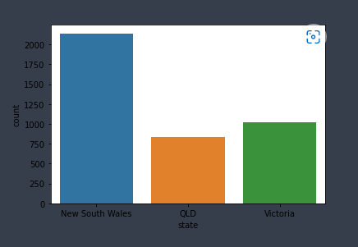
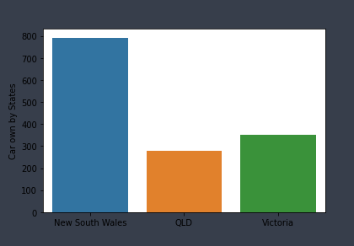
Note: The data and information in this document is reflective of a hypothetical situation and client. This document is to be used for KPMG Virtual Internship purposes only.
Interpretation
Cars owns by states
More than 2000 states are New South Wales which indicate that most of the peoples are from NSW.
Cars owned by each states represented below
Place any supporting images, graphs, data or extra text here.

